Slide 2
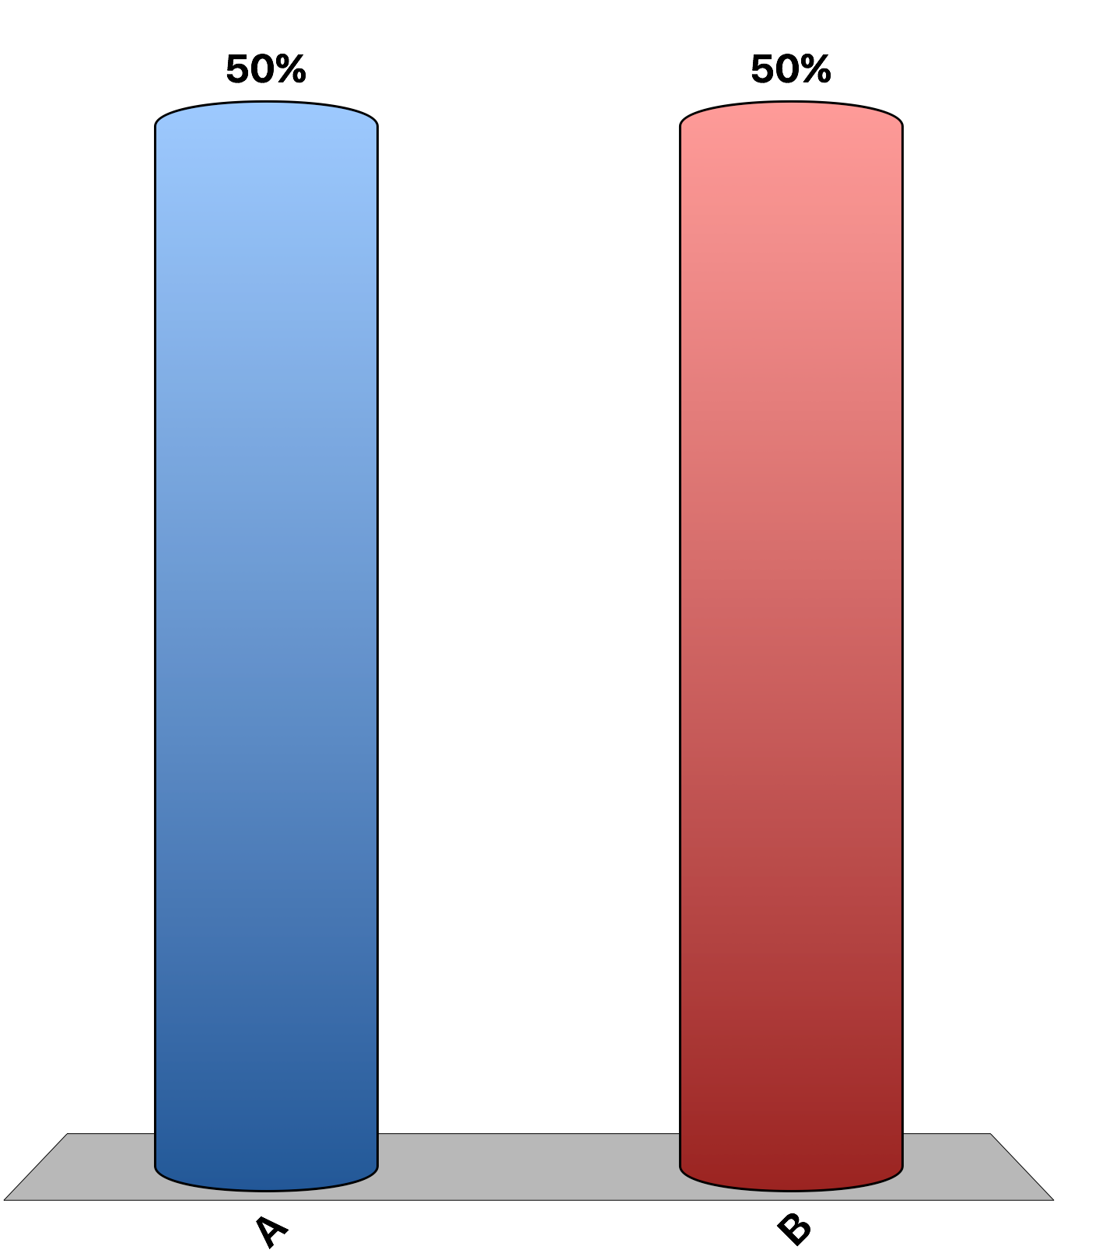
The price elasticity of supply measures how much the quantity supplied of good X responds to changes in the price of good X.
True
False

Slide 3
If farmers become more productive in growing wheat, total revenue of wheat farmers will rise.
True
False

Slide 4
A demand curve with a price elasticity of zero is a horizontal line.
True
False

Slide 5
A vertical supply curve has a price elasticity of zero.
True
False

Slide 6
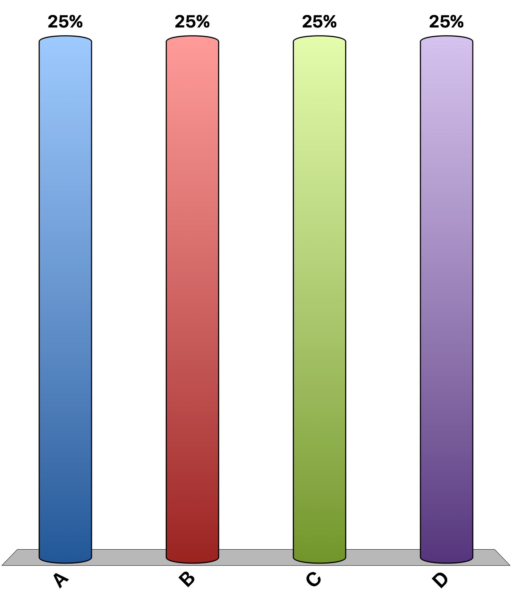
Which of the following goods would have the least elastic demand?
milk
2% milk
chocolate milk
Because each example describes milk, the price elasticity of demand will be the same for each good.

Slide 7
Which of the following statements is correct?
the demand for hamburgers is more elastic than the demand for Kobe beef.
the demand for ice cream is more elastic than the demand for chocolate ice cream.
the demand for Coca-Cola is more elastic than the demand for soda.
the demand for gasoline is more elastic in the short-run than in the long-run.

Slide 8
If the price of yachts were to decrease by 10%, we would expect the number of yachts purchased to
increase by more than 10%.
increase by less than 10%.
remain the same.
decrease slightly.

Slide 9
If the price elasticity of demand for beef is 1.6, then a 10% increase in the price of beef would be expected to result in a
60% increase in quantity demanded.
60% decrease in quantity demanded.
16% increase in quantity demanded.
16% decrease in quantity demanded.

Slide 10
Suppose the price of a Snickers bar is reduced from $1.65 to $1.35, and as a result the quantity demanded increases from 1,400 to 1,600. Using the midpoint method, the price elasticity of demand for Snickers in the given price range is
2/15.
3/15.
2/3.
3/2.

Slide 11
The athletic director of State U suggests that the university should reduce ticket prices to its football games in order to increase both attendance and revenue from ticket sales. Economic theory predicts that, for a price elastic demand, this price reduction would
have no effect on attendance and increase revenue.
decrease attendance and increase revenue.
increase attendance and increase revenue.
increase attendance and decrease revenue.

Slide 12
The price elasticity of demand for gasoline has been estimated to be 0.2 for a 3-month time period. During that time period, how will an increase in the supply of gasoline affect the total revenues of sellers of gasoline?
Total revenues will rise.
Total revenues will fall.
Total revenues will not change.
The effect on total revenue cannot be predicted.

Slide 13
Last year Ashley bought 6 pairs of shoes when her income was $40,000. This year her income is $50,000, and she purchased 10 pairs of shoes. Ashley’s
income elasticity of shoes is positive.
income elasticity of shoes is negative.
price elasticity of demand for shoes is less than 1.
Both a and c are correct.

Slide 14
The cross-price elasticity of demand between golf balls and golf clubs is
positive.
negative.
zero.
one.

Slide 15
A combination of great weather and beneficial scientific discoveries lead to a doubling of the per acre yield in cotton fields. Assume the demand for cotton is inelastic. Will the cotton farmers be better off?
Yes
No
Notes:
An increase in per acre yield increases the supply of cotton, and that lowers the market price. Because we assume the demand for cotton is inelastic, the lower price leads to a lower total revenue (the gains in revenue from the increased quantity sold are more than offset by loses of revenue due to the lower price). The cotton farmers will be worse off.

